Slide 1
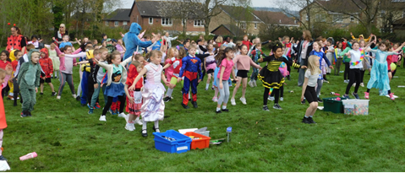
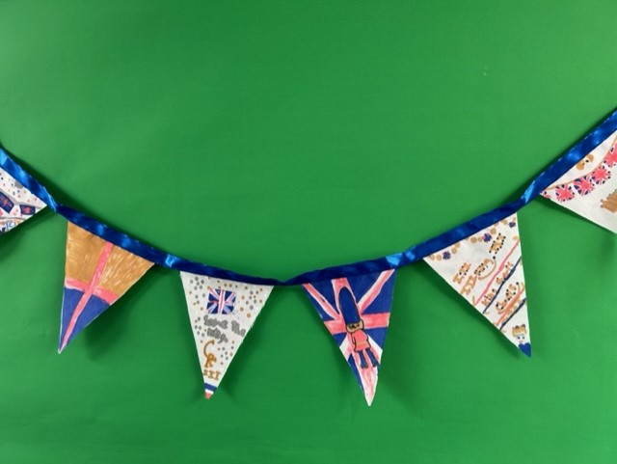

Wellbeing at Avishayes
Our wellbeing journey 2023

Slide 2

What is wellbeing?
What do we mean when we talk about wellbeing?
How do we promote wellbeing?
How do we support those in need?

Slide 3
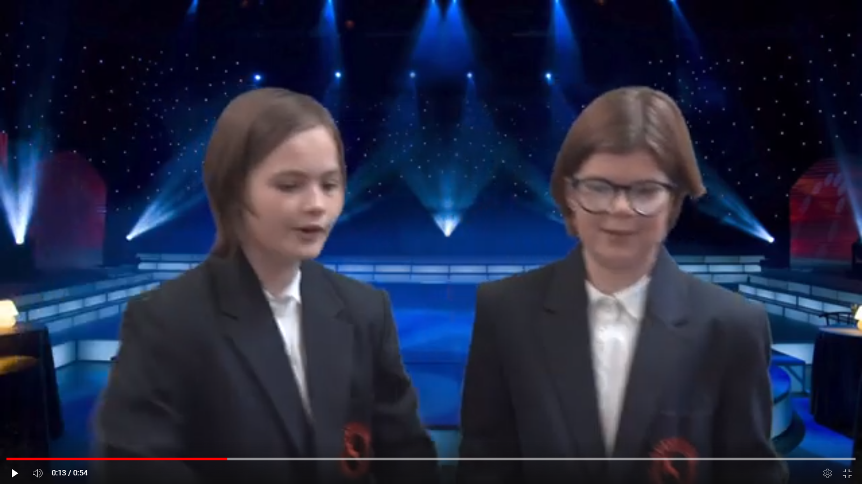
What do we mean when we talk about wellbeing?
Year 6 performed scenarios to the rest of the school in an assembly to promote anti-bullying (Max + Scarlett)
Year 6 worked on peer pressure videos with Somerset https://youtu.be/SezUXe6iTAQ and learn about getting on in class (Amber + Issy)
5 ways to promote wellbeing – Wellbeing Week and learn a new skill afternoon – physical and mental wellbeing (Amber + Issy)
Assemblies promote wellbeing including NSPCC (Nadia + Sophie)

Slide 4

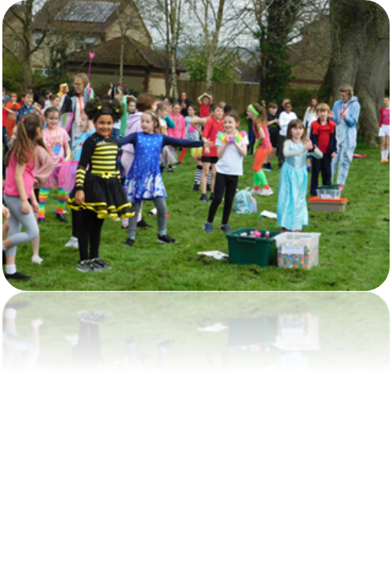
How do we promote wellbeing?
Wellbeing ambassadors notice kindness and recognise good wellbeing (Tristan + Athan)
We mark special days like ‘Wear Your Scarf to School,’ and ‘Odd Socks Day’ to show that everyone is special and unique (Sophie + Nadia)
We have held whole school events like the ‘Fun Run’ and ‘Coronation Picnic’ (Sophie + Nadia)
We held an Ambassadors Tea Party (Nadia + Max)

Slide 5
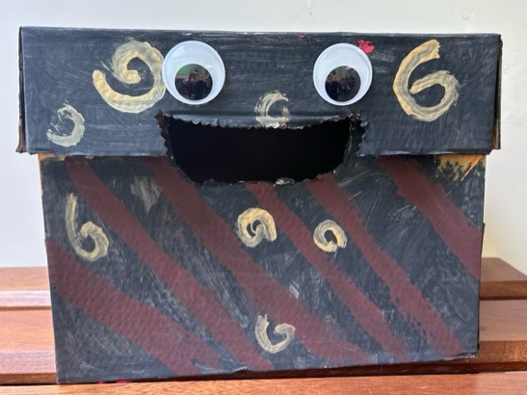
How do we support those in need?
We made worry boxes for each class (Tristan + Sophie)
In the Autumn we boxed up shoeboxes for children in other countries in need (Scarlett + Athan)
We use ‘Happy Sheets’ to share how we are feeling (Max + Issy)
We did a survey/audit of how people were feeling at playtimes and worked with School Council to improve playtimes (Nadia + Max)

Slide 6
Next steps …
Another Ambassadors’ Tea Party
Class Kindness Sheet of hearts
Plan a Wellbeing day for after half-term

